Slide 1
PRESENTATION TOPIC: HISTORY OF INTERNET
Course Title: English Language and Literature
Course Code: ICT-1211
Presented By:
Musfiq Alam
ID: IT 25054
Department of ICT,
MBSTU
Supervised By:
Dr. Nazrul Islam
Associate Professor
Department of ICT,
MBSTU

Slide 2

The Amazing Journey of the Internet
A clear, human-centred tour through how the internet began and grew into the global network we use today. This presentation uses simple language, key dates, and images to make the story easy to follow.
Reference: Imperial (1)

Slide 3
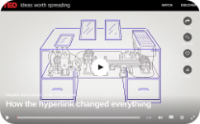
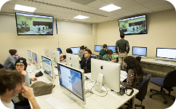
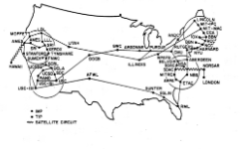
From Ideas to Connections:
The Very Beginning
The Spark of an Idea (1945)
Early Research (1960s)
ARPANET Launched (1969)
Vannevar Bush described the "Memex", a hypothetical machine for storing and linking information — an early vision of networked knowledge.
ARPA (Advanced Research Projects Agency) funded research into connecting different computer systems — laying groundwork for shared networks.
The first packet-switched network connected four sites, proving computers could exchange data reliably across distances.
Reference: Internet Society — "Brief History of the Internet".(1)

Slide 4
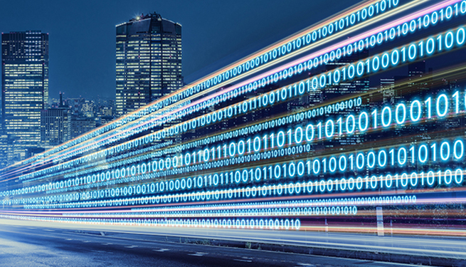

Building the Foundations: Key Technologies
Email Arrives (1971)
Ray Tomlinson sent the first network email and introduced the user@host addressing format that still exists today.
TCP/IP — The Internet's Language (1974)
Bob Kahn and Vint Cerf designed TCP/IP to let different networks communicate, forming the technical backbone of the internet.
Domain Names (1983)
DNS introduced readable addresses like ".com" and ".org", making the network far easier to navigate for people.
Reference: UC Berkeley School of Information — HOFI presentation (HOFIInternetI4-23).(2)

Slide 5
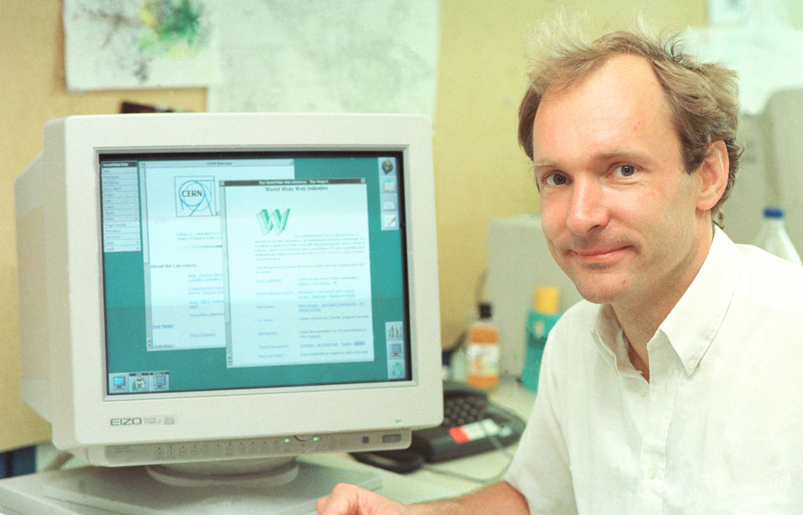
The World Wide Web: Making it User-Friendly
Web Technologies (1990)
Mosaic Browser (1993)
Tim Berners-Lee created HTML, HTTP and the first web browser — tools that let people create and view web pages easily.
Mosaic brought images and text together in a single view and was available across platforms, which helped the web reach a broader audience.
Commercial access expanded in the early 1990s as restrictions were relaxed and companies built browsers and services that reached the public. Reference: Frank McCown — "A Short History of the Internet and the Web".(3)

Slide 6
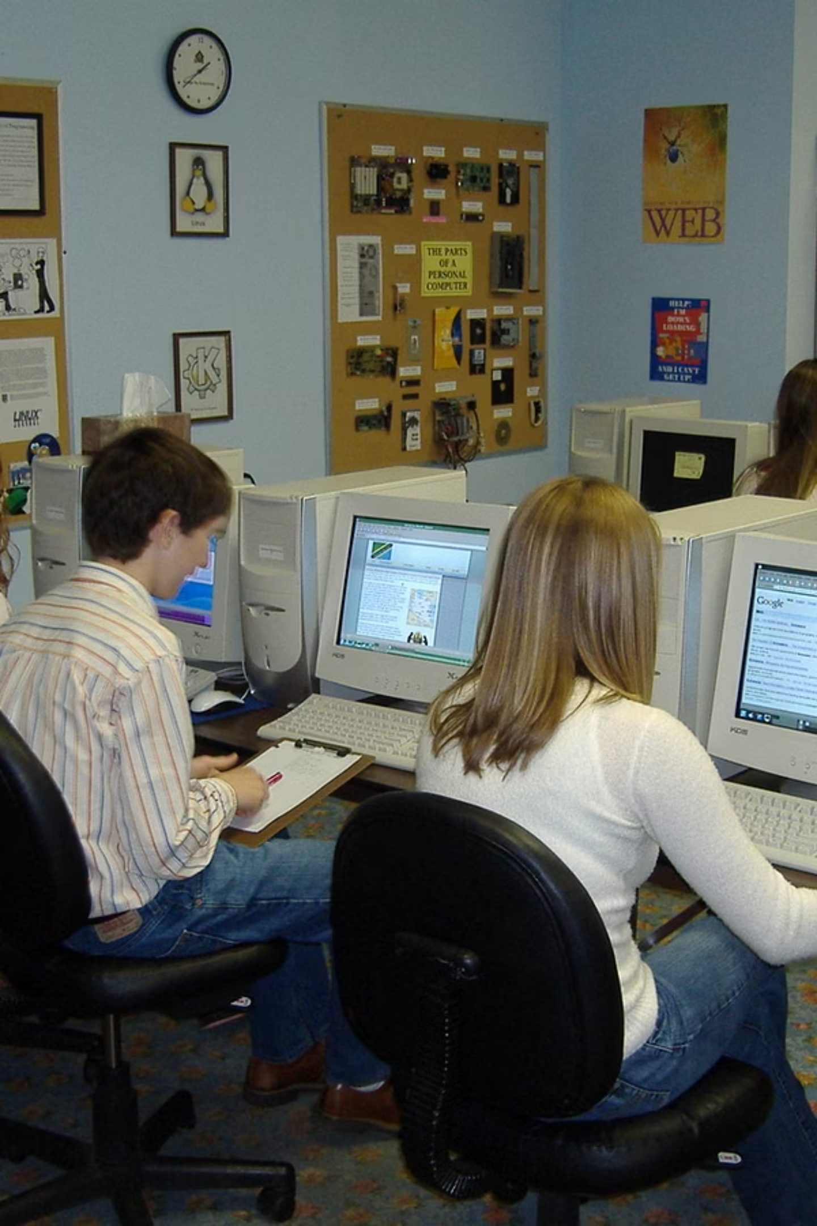
The Internet Grows Up: From Research to Everyone
NSFNET Backbone
NSFNET connected universities and research centres, providing a major backbone that supported growth through the 1980s and early 1990s.
Commercial Networks and ISPs
Commercial providers began offering internet access to businesses and the public, turning a research tool into a public service.
Internet Society (1992)
The Internet Society was formed to guide standards, policy and education as the network scaled worldwide.
Reference: Internet Society — "Brief History of the Internet".(4)

Slide 7
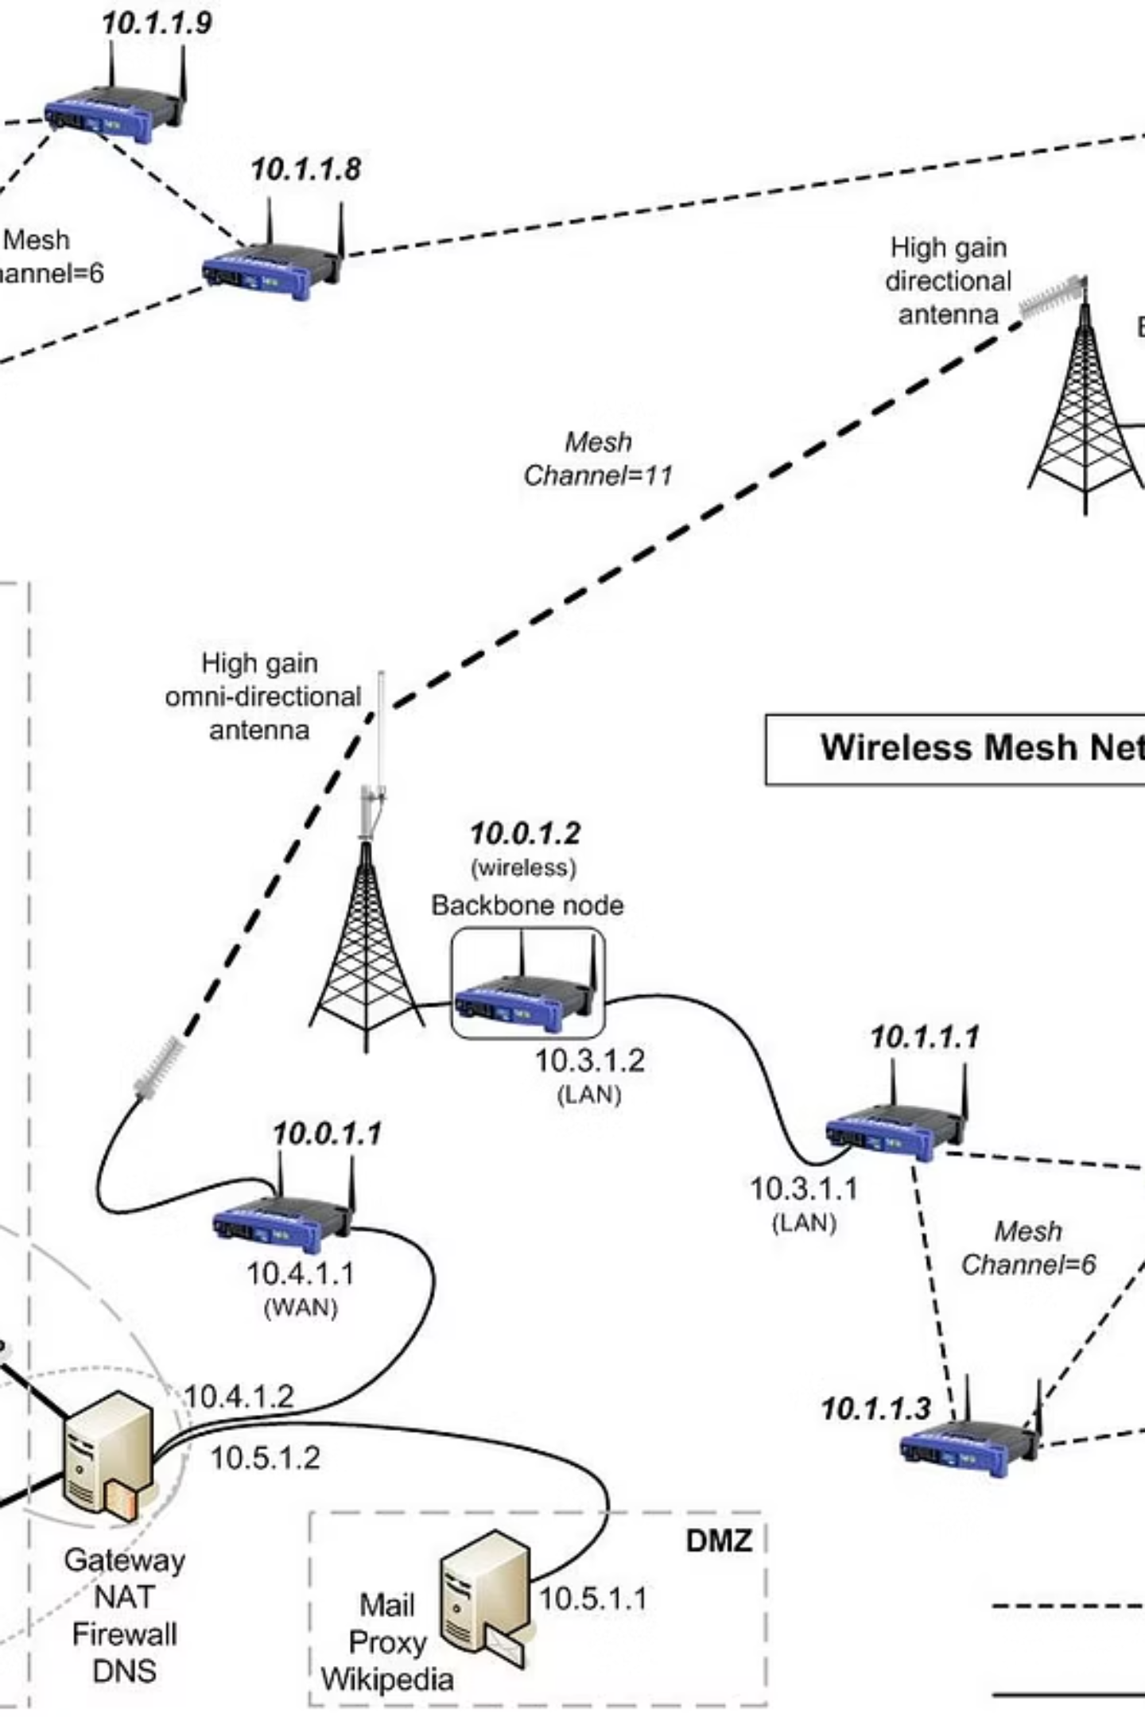
Connecting the World
The network of networks grew into a global infrastructure. As links multiplied, remote communities, governments and businesses all became part of the same information space. Images like this show the idea: many independent nodes connecting to form one global web.

Slide 8
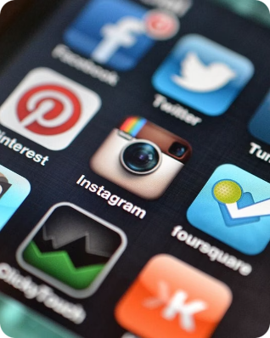
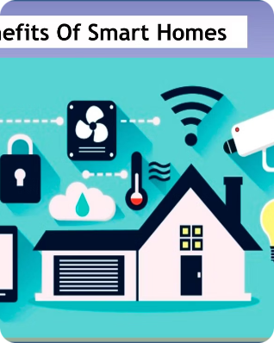
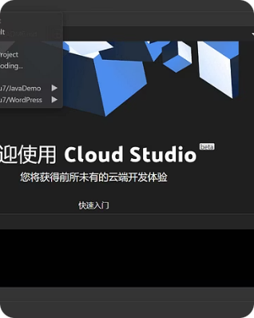
The Internet Today: A Global Phenomenon
Information at Your Fingertips
Beyond Computers
Constant Evolution
The internet gives quick access to news, research, learning and entertainment for billions of people worldwide.
Internet-connected devices — phones, watches, appliances — bring connectivity into everyday objects.
New applications, protocols and services continue to change how we use the network and what it enables.
Reference: Internet Society — "Brief History of the Internet".(5)

Slide 9
Key Milestones
1969 — ARPANET
1
First operational packet-switched network.
2
1971 — First Email
Ray Tomlinson sends the first message across a network.
1974 — TCP/IP
3
Standards enabling network interoperability are defined.
4
1983 — DNS
Human-friendly domain names are introduced.
1990–1995 — Web & Growth
5
World Wide Web created; web browsers and commercial use expand rapidly.

Slide 10
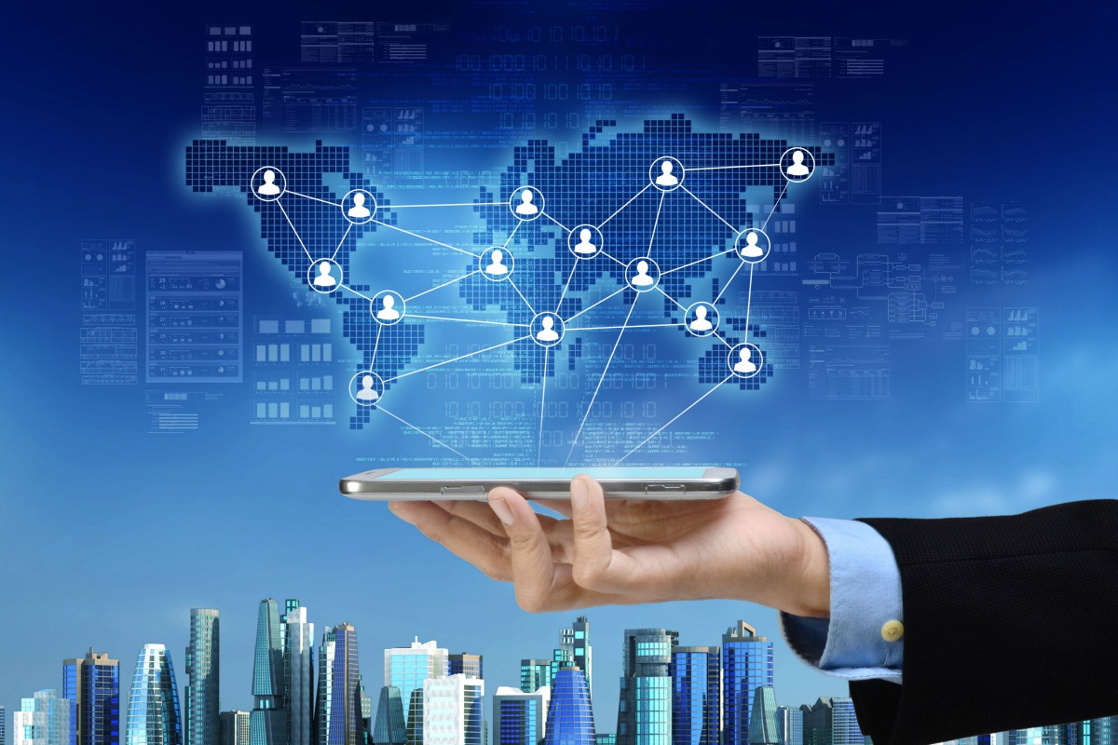
The Internet: A Revolution in Communication
The internet transformed how we communicate, learn and work. What began as specialised research tools became public platforms for commerce, education and social life. Today, its benefits come with responsibilities — privacy, security and equal access remain important global challenges.

Slide 11

References
Primary Sources
Academic Overview
Web History
Frank McCown — "A Short History of the Internet and the Web"
https://sites.harding.edu/fmccown/history-of-internet-and-web.pdf
Internet Society — "Brief History of the Internet"
https://www.internetsociety.org/resources/doc/2017/brief-history-internet/
UC Berkeley School of Information — HOFIInternetI4-23
https://courses.ischool.berkeley.edu/i103/s09/slides/HOFIInternetI4-23.pdf
If you have questions, I’m happy to expand any slide or add simple speaker notes.

Slide 12
Thank You

